Slide 1
What Causes Pollution
Yes /No/Unsure
Clean Air School’s Programme

Slide 2
Main Pollutants of Concern
Nitrogen dioxide – toxic gas that impacts on respiratory health (mainly from combustion in air)
Particulate matter – comes from many sources both natural and manmade. Usually always present when a fuel is combusted but also formed during abrasion of surfaces, braking of vehicles, during construction, demolition and quarrying.
Particulate matter is referred to by the size of the particle.
  Coarse particles have a diameter of >10 microns – usually stopped by the nose
  PM10 is particles up to 10 microns – these can enter the lungs and cause respiratory problems
  PM2.5 is particles less than 2.5 microns that can get very deep into the longs and interfere with gas exchange
Notes:
KEY MESSAGES ABOUT AIR POLLUTANTS TO GET ACROSS.
Some air pollutants have local impacts causing health problems. For example, particles and nitrogen dioxide. These are the main pollutants measured in Bradford.
Some air pollutants aren’t very harmful to health but contribute to global warming (this can have local impacts such as flooding) e.g. carbon dioxide and methane. These are given out when fossil fuels or wood are burnt or when a natural material is digested or decomposes (rots).
Most combustion processes create some particulate matter and nitrogen dioxide. The particulate matter comes from the incomplete combustion of the fuel, the nitrogen dioxide comes mainly from the combustion of the nitrogen and oxygen in the air caused by the hot temperatures when the fuel is burnt. Combustion of fossil fuels and wood also causes carbon dioxide to be emitted.
Fuels like wood and coal contain sulphur which ends up being emitted as sulphur dioxide. This can cause local health issues but also acid rain that damages buildings and plants.
Lots of particulate emissions arise from sources other than combustion. For example, an electric car still produces particles due to contact with the road surface and braking.

Slide 3
Main Pollutants of concern cont…
Carbon dioxide – released whenever fossil fuels or wood is combusted. Not harmful to health but it is a greenhouse gas that causes global warming. Global warming can have local impacts.
Methane – mainly released when something that contains carbon is decomposed or consumed. It is a potent greenhouse gas.

Slide 4
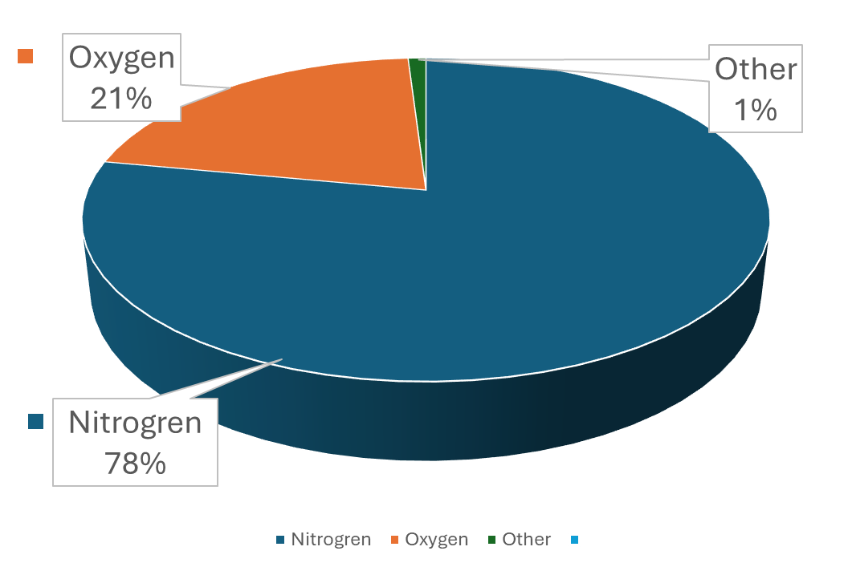

Earth’s atmosphere is composed of about 78% nitrogen, 21% oxygen, and 1% other gases

Slide 5
Yes, No or Unsure?
Notes:
Can you categories the following pictures into what you think causes pollution, what you think doesn’t cause pollution and what you are unsure of.

Slide 6
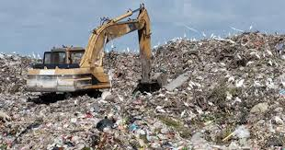
Landfill site (methane / particulate)
Notes:
Landfill site (methane / particulate)
Landfill site (methane / particulate)
When materials are brought to the landfill site and tipped in a lot of dusty material called particulate matter is released. As materials decay (rot) in the landfill site they produce methane gas and carbon dioxide.

Slide 7
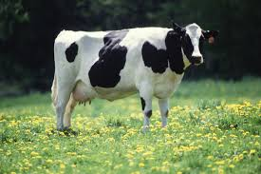
Cow (methane / ammonia)
Notes:
Cow (methane / ammonia)
When the cow digests (eats) food it creates methane gas. The cow then releases the gas as waste (trumps).
When cows wee the urine in their wee reacts in the environment to make ammonia.

Slide 8
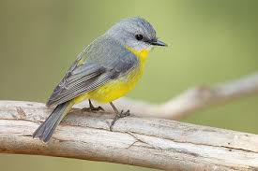
Bird (not polluting)
Notes:
Bird (not polluting)

Slide 9
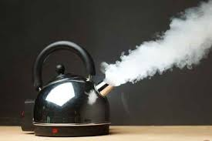
Boiling kettle (with steam)
Notes:
Boiling kettle (with steam) (steam isn't a pollutant)

Slide 10

Boat (with an engine) (nitrogen dioxide, particulate)
Notes:
Boat (with an engine) (nitrogen dioxide, particulate)
Boats usually have diesel engines. When diesel combusts in air it creates small sooty particles. The hot temperatures caused by the combustion causes nitrogen in the air to react with oxygen to form oxides of nitrogen (such as nitrogen dioxide). The combustion of the diesel also releases carbon dioxide.

Slide 11
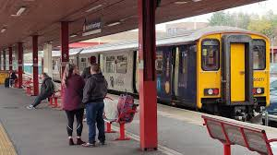
Train (nitrogen dioxide)
Notes:
Train (nitrogen dioxide, particulate if diesel - electric trains not polluting)
When diesel combusts in air it creates small sooty particles. The hot temperatures caused by the combustion causes nitrogen in the air to react with oxygen to form oxides of nitrogen (such as nitrogen dioxide). As the train moves along the railway line it also cause fine particles to be emitted due to friction between the wheels and the railway line and disturbance of any dirt present. The combustion of the diesel also releases carbon dioxide.
Electric trains
Electric trains don't have an engine on board so don't cause pollution from burning diesel. Like diesel trains they still cause emissions of small particles as they move along the rails due to friction and disturbance of any dirt present . The electric to run the trains has to be produced in a power station and there may be some emissions to air produced at the power station in a different location. Electric trains are the least emitting when they run on 'green' energy'-energy created from wind, solar or hydroelectric power.
Steam trains
Steam trains burn coal to create steam which powers the train. Burning coal creates smoke particles and sulphur dioxide gas. The hot combustion process also causes nitrogen in the air to react with oxygen to form oxides of nitrogen (such as nitrogen dioxide). Like other trains steam trains also emit small particles as they move along the rails due to friction and disturbance of dirt. The combustion of the coal also releases carbon dioxide.

Slide 12
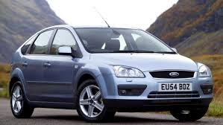
Car (nitrogen dioxide, particulate)
Notes:
car (nitrogen dioxide, particulate)
Electric cars not polluting.
Diesel Cars
When diesel combusts in air it creates small sooty particles. The hot temperatures caused by the combustion causes nitrogen in the air to react with oxygen to form oxides of nitrogen (such as nitrogen dioxide). As the car moves along the road it also causes fine particles to be emitted due to friction between the wheels and the road and disturbance of any dirt present. When the brakes are applied some fine particles are also emitted from the brakes. The combustion of the diesel also releases carbon dioxide.
Petrol cars
When petrol combusts in air it forms less particles than diesel and burns at lower temperatures so creates less oxides of nitrogen. Petrol cars are usually less polluting than a similar size diesel car. As the car moves along the road it causes fine particles to be emitted due to friction between the wheels and the road and disturbance of any dirt present. When the brakes are applied some fine particles are also emitted from the brakes. The combustion of the petrol also releases carbon dioxide.
Electric cars
Electric cars don't burn fuels. They have a battery that stores electric so they can travel around towns and cities without causing lots of air pollution from their exhaust pipes. The electric that goes into the battery still has to be produced in a power station so there could be some emissions to air outside cities and towns where power stations are located. The cleanest electric vehicles are those which use 'green' energy produced from wind, solar and hydro-electric power stations. Like other vehicles electric cars still produce particulate matter due to friction between the wheels and the road and disturbance of any dirt present.

Slide 13
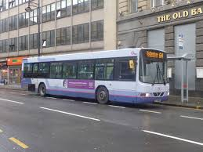
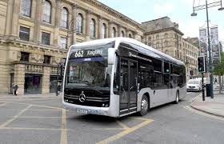
Buses
Notes:
Diesel bus - Polluting
Electric Bus not polluting
Diesel Buses
Diesel buses have big powerful diesel engines. When diesel combusts in air it creates small sooty particles. The hot temperatures caused by the combustion also cause nitrogen in the air to react with oxygen to form oxides of nitrogen (such as nitrogen dioxide). The combustion of the diesel also releases carbon dioxide. As the bus moves along the road it also causes fine particles to be emitted due to friction between the wheels and the road and disturbance of any dirt present. When the brakes are applied some fine particles are also emitted from the brakes. As buses have much bigger engines than cars, they are usually more polluting but if a bus can replace 60 individual cars on the road it will create less pollution overall. Less pollution is created if people share the same transport. In Bradford only the newest cleanest lorries can travel in the Clean Air Zone for free. Older polluting buses have to pay a charge to enter. This is to encourage bus companies to get newer cleaner vehicles (like electric ones) or to clean up the ones they already have.
Electric buses
Electric buses don't burn fuels. They have a battery that stores electric so they can travel around towns and cities without causing lots of air pollution from their exhaust pipes. The electric that goes into the battery still has to be produced in a power station so there could be some emissions to air outside cities and towns where power stations are located. The cleanest electric buses are those which use 'green' energy produced from wind, solar and hydro-electric power stations. Like other vehicles electric buses still produce particulate matter due to friction between the wheels and the road and disturbance of any dirt present.

Slide 14
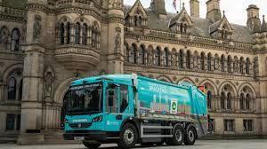
Electric Vehicles
Notes:
Electric Wagon not Polluting

Slide 15
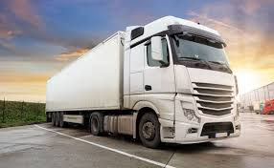
Lorries
Notes:
lorry (nitrogen dioxide, particulate)
Lorries
Lorries have big powerful diesel engines. When diesel combusts in air it creates small sooty particles. The hot temperatures caused by the combustion also cause nitrogen in the air to react with oxygen to form oxides of nitrogen (such as nitrogen dioxide). The combustion of the diesel also releases carbon dioxide. As the lorry moves along the road it also causes fine particles to be emitted due to friction between the wheels and the road and disturbance of any dirt present. When the brakes are applied some fine particles are also emitted from the brakes. As lorries have much bigger engines than cars, they are usually more polluting. In Bradford only the newest cleanest lorries can travel in the Clean Air Zone for free. Older polluting lorries have to pay a charge to enter. This is to encourage people to get newer cleaner vehicles or to clean up the ones they already have.

Slide 16
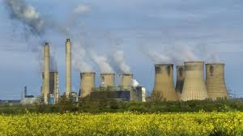
Power station
(nitrogen dioxide, particulate, sulphur dioxide)
Notes:
power station (nitrogen dioxide, particulate, sulphur dioxide)

Slide 17
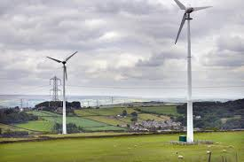
Wind Turbine
Notes:
wind turbine(not polluting)

Slide 18

Fireworks
Notes:
firework (particualte, sulphur dioxide, nitrogen dioixde)
Fireworks
Fireworks contain lots of different chemicals that create pretty colours when they burn. When fireworks burn they release harmful gases like sulphur dioxide and nitrogen dioxide and create lots of fine particles. Air pollution levels in Bradford are much worse when people use fireworks to celebrate events.

Slide 19
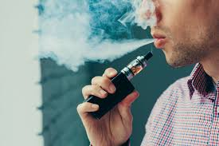
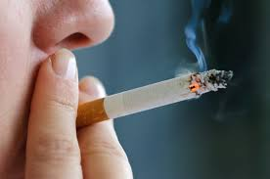
Cigarette or vape (particulate)
Notes:
Cigarette or vape (particulate)
Cigarettes
When a cigarette burns it creates small particles and other toxic gases that can get into your lungs and cause health problems such as cancer. The combustion of the cigarette also releases carbon dioxide and quite often carbon monoxide (which in high concentrations is poisonous).

Slide 20
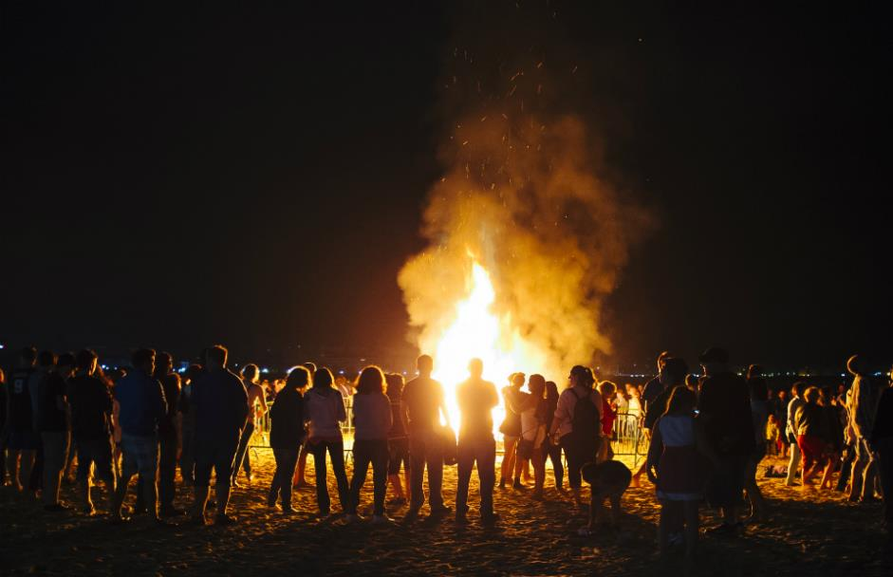
Bonfires
Notes:
bonfire (particualte, nitrogen dioxide)
Bonfires
Bonfires create lots of different air pollution depending on what is being burnt. If the bonfire contains lots of wood it will create lots of particles and some sulphur dioxide. The hot temperatures caused by the fire also make nitrogen in the air react with oxygen to form oxides of nitrogen, including nitrogen dioxide. Bonfires also release lots of carbon dioxide.

Slide 21
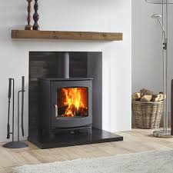
Wood burning stoves
Notes:
wood burning stove (particualte, nitrogen dioixde)
Wood burning stoves
Buring wood in a stove is a combustion process that creates particles and other gases like sulphur dioxide. The hot temperatures also cause nitrogen dioxide in the air to react with oxygen to form oxides of nitrogen, such as nitrogen dioxide. Burning wood also releases carbon dioxide. If you burn old wood that has been painted or treated with chemicals, you can get lots of other nasty chemicals being produced that end up in your home. Wet wood will create lots of sooty particles and smoke. You should only ever burn clean dry wood on a wood burning stove and make sure you store wood in a dry place before using it.
Coal fire place
Buring coal is a combustion process that creates particles and other gases like sulphur dioxide. The hot temperatures also cause nitrogen dioxide in the air to react with oxygen to form oxides of nitrogen, such as nitrogen dioxide. Burning coal also releases carbon dioxide. Some coals are not very good quality and cause lots of smoke. It is better to use special smokeless fuels on a fire in your home.

Slide 22
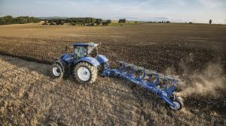
Tractor ploughing a field
Notes:
tractor ploughing a field (particulate)
Tractor ploughing a field
When a field is ploughed lots of dust is created releasing particles into the atmosphere. Tractors also have big diesel engines. When diesel combusts in air it creates small sooty particles. The hot temperatures caused by combustion also cause nitrogen in the air to react with oxygen to form oxides of nitrogen (such as nitrogen dioxide). Buring diesel also creates carbon dioxide. As the tractor moves across the fields and roads, it also emits fine particles due to friction between the wheels and the road and disturbance of the soil.

Slide 23
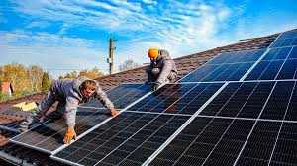
Solar Panels
Notes:
Solar panel (not polluting)

