Slide 1
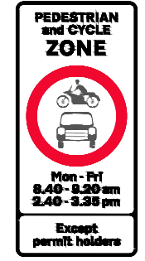

What is a School Street ?
A School Street scheme is where vehicle access is restricted on a certain streets, near to school, at the beginning and end of a school day.
The aim of a School Street is to help:
Reduce congestion around the school
Prevent dangerous driving, parking and turning when there are lots of children and parents about
Reduce air pollution (caused by engines running) and noise pollution
Provide a safer, calmer, happier, healthier space for our children
Encourage walking, cycling, wheeling and scooting to school

Slide 2
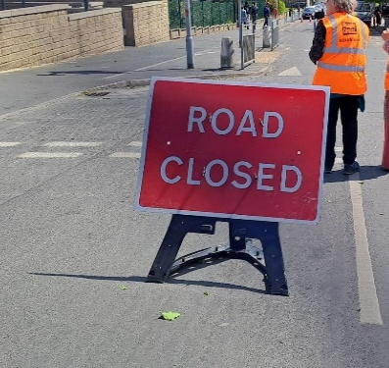
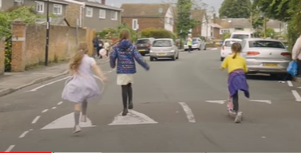
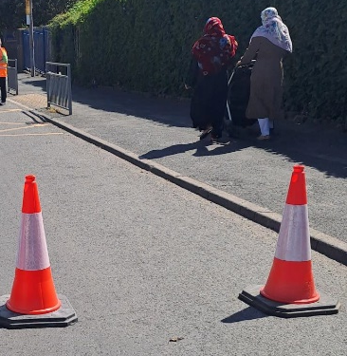
What is a School Street ?
A school Street scheme is designed to reduce traffic on the road(s) near to school
A School Street scheme will not remove all traffic (residents will always be allowed access and there are some other exemptions)
A school street scheme doesn’t mean that children will never travel to school by car (those families still needing to travel by car are encouraged to park safely and considerately further away from school)

Slide 3
The journey from interest to launch:
Council | School
Assess site to determine suitability | Submit expression of interest
Draw up traffic management plan | Engage and consult with parents / carers & pupils
Engage with elected members | Recruit stewards (staff or parent volunteers)
Consult and inform residents and local businesses | Participate in Training
Undertake legal processes (to allow the Traffic Regulation Order to be implemented) | Sign MOU
Sign manufacture and installation | Launch School Street
Provide resources (signs, cones, guidance, letter templates, risk assessment etc.) | Ongoing stewarding role (to encourage driver compliance)
Evaluate | Ongoing communication & engagement with parents / carers

Slide 4
The role of a steward:
Stewards should:
Put out the portable road closed signs & be a visible presence
Thank those who are doing the right thing
Answer questions & talk positively about the scheme and its wider benefits.
Direct comments, queries or complaints to school.streets@Bradford.gov.uk
Stewards should not
Get involved in an argument or confrontation
Try to physically stop drivers/ vehicles (Only the police can do this)

Slide 5
Other help / Support:
The Road Safety team: 01274 437409 / roadsafety@bradford.gov.uk
Clean Air Schools Programme: Clean Air Schools Grant Programme | Bradford Council
Living Well Schools Home - Living Well Schools (mylivingwell.co.uk)
Living Well 20 Minute Movement Campaign: 20 Minute Movement - Living Well (mylivingwell.co.uk)
Living Streets Walk to School | Living Streets

